Slide 1
If you want to attract you costumer
Super-Screen | Marketing project
By:
Khalil Abdeljawad - Hasan Sidawi

Slide 2
Agenda Style
01
Idea / Overview
What is Super-Screen?
02
System Architecture
How is the system designed and structured?
03
Costumer Journey
How to use the system?
04
System Values
Why is this system AWESOME?

Slide 3
Idea / Overview
“Connect markets to end users at real time”

Slide 4
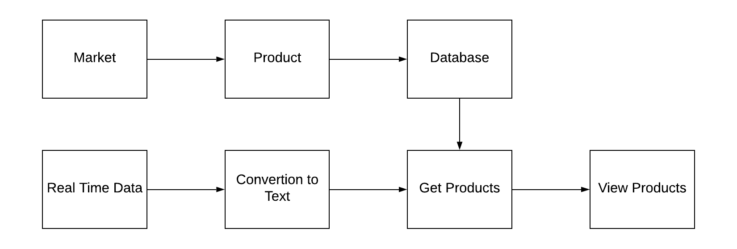
System Architecture

Slide 5
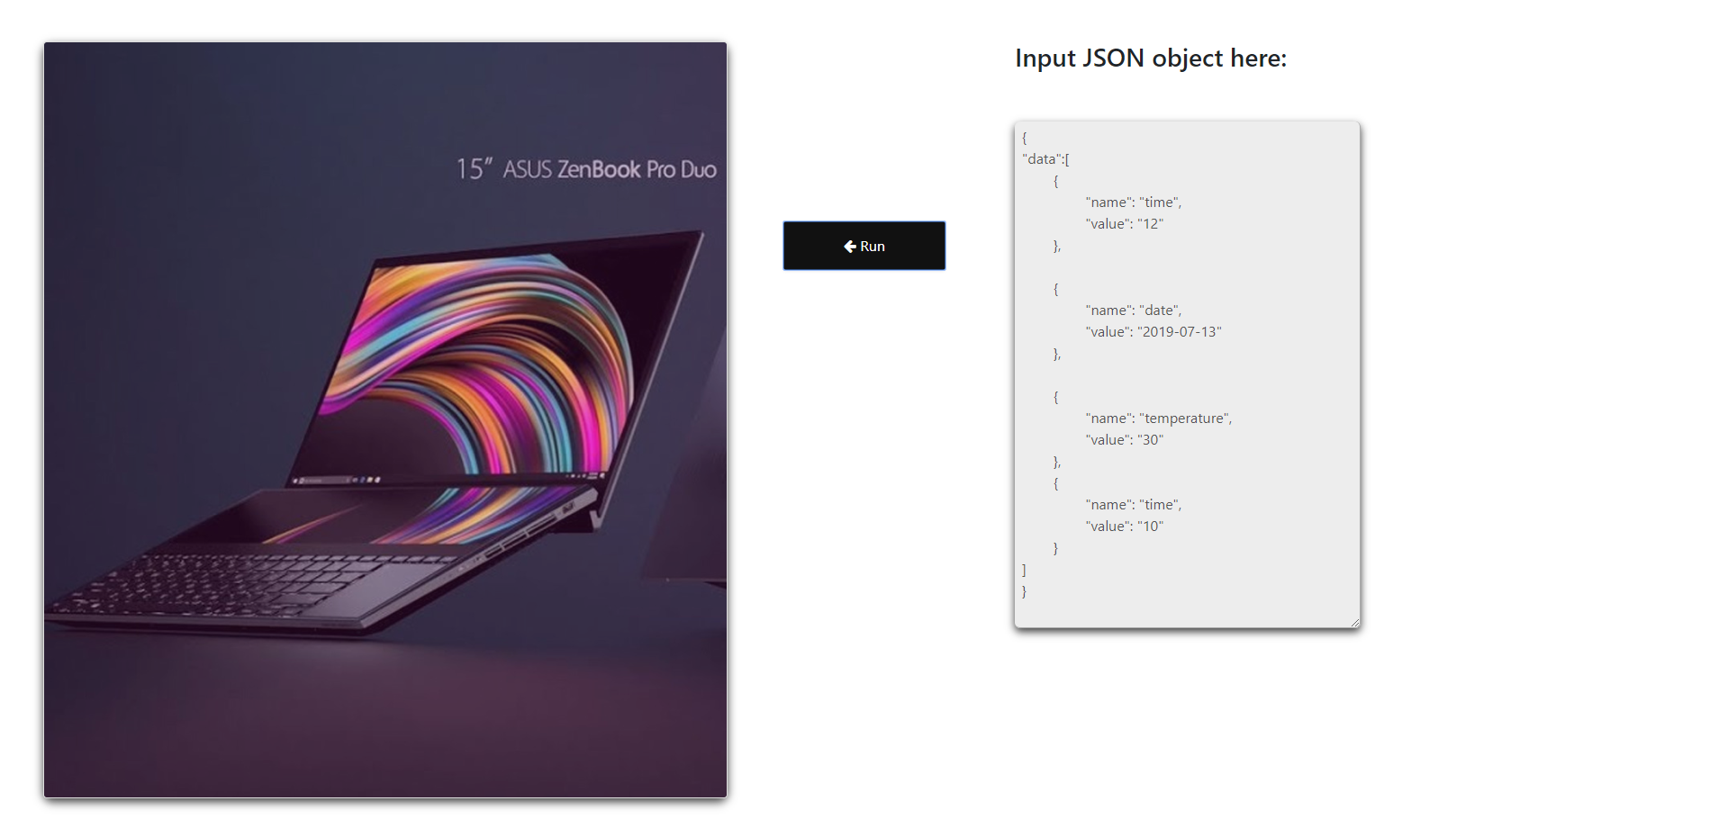
Costumer Journey

Slide 6
System Values
1
Smart
2
Predict user needs
Real time
Real time response.
3
Simple
4
Easy to use.
Saleable
We used APIs, JSON

Slide 7
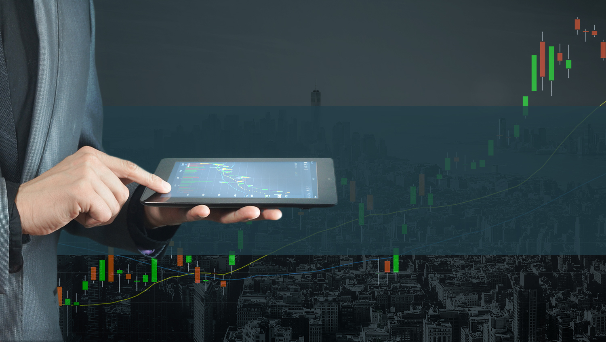
Thank You!

